Slide 1


Oops & Fix Manufacturing Co.:
A Data-Driven Rebirth from the Brink of Bankruptcy
Yingtong Wang
Huangkun Chen
Notes:
“Hello everyone! Today, I’ll share how we used data science to save Oops & Fix Manufacturing Co. from bankruptcy. It’s a story of turning data into solutions and challenges into success.”

Slide 2

BACKGROUND
Oops & Fix Manufacturing Co., a mid-sized manufacturing company, was facing the ultimate existential threat: bankruptcy. The board was out of options.
No Time to Waste!!!!
Notes:
“Oops & Fix was in deep trouble. The company was close to bankruptcy, and the board didn’t know what to do. That’s when the CFO called in a team of data scientists to help turn things around.”

Slide 3
A Treasure Chest of Data
The CFO brought in the big guns: a team of data scientists armed with SAS Enterprise Miner
We utilized financial disclosure data from over 10,000 peer companies, covering 64 key financial indicators, to train and validate the model.
Profitability Indicators
attr1 (Profitability ratio), attr7 (Return on assets)
Debt Ratios
attr2 (Debt ratio), attr15 (Debt cycle)
Operational Efficiency
attr9 (Total asset turnover), attr43 (Accounts receivable and inventory turnover days)
Liquidity Measures
attr4 (Current ratio), attr46 (Net liquid asset-to-short-term liabilities ratio)

Slide 4
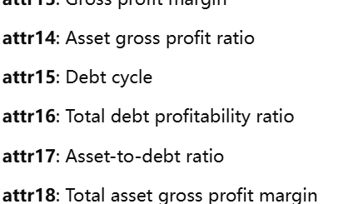
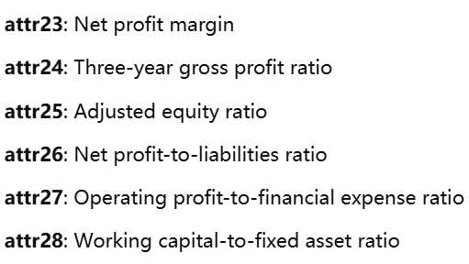
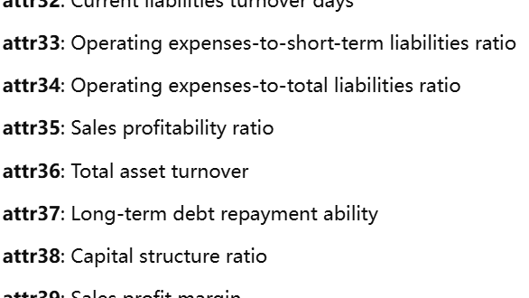
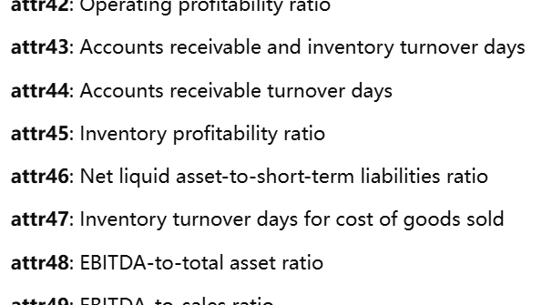
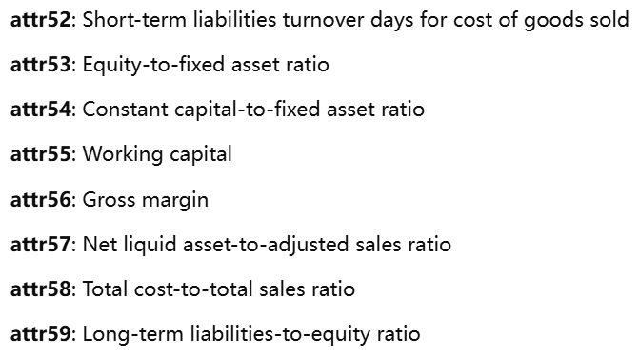
Introduce Data

Slide 5

The Data Detective
Step 1: Cleaning the Clues(Outliers)
Step 2: Building the Models
Step 3: The Hunt for Key Drivers

Slide 6
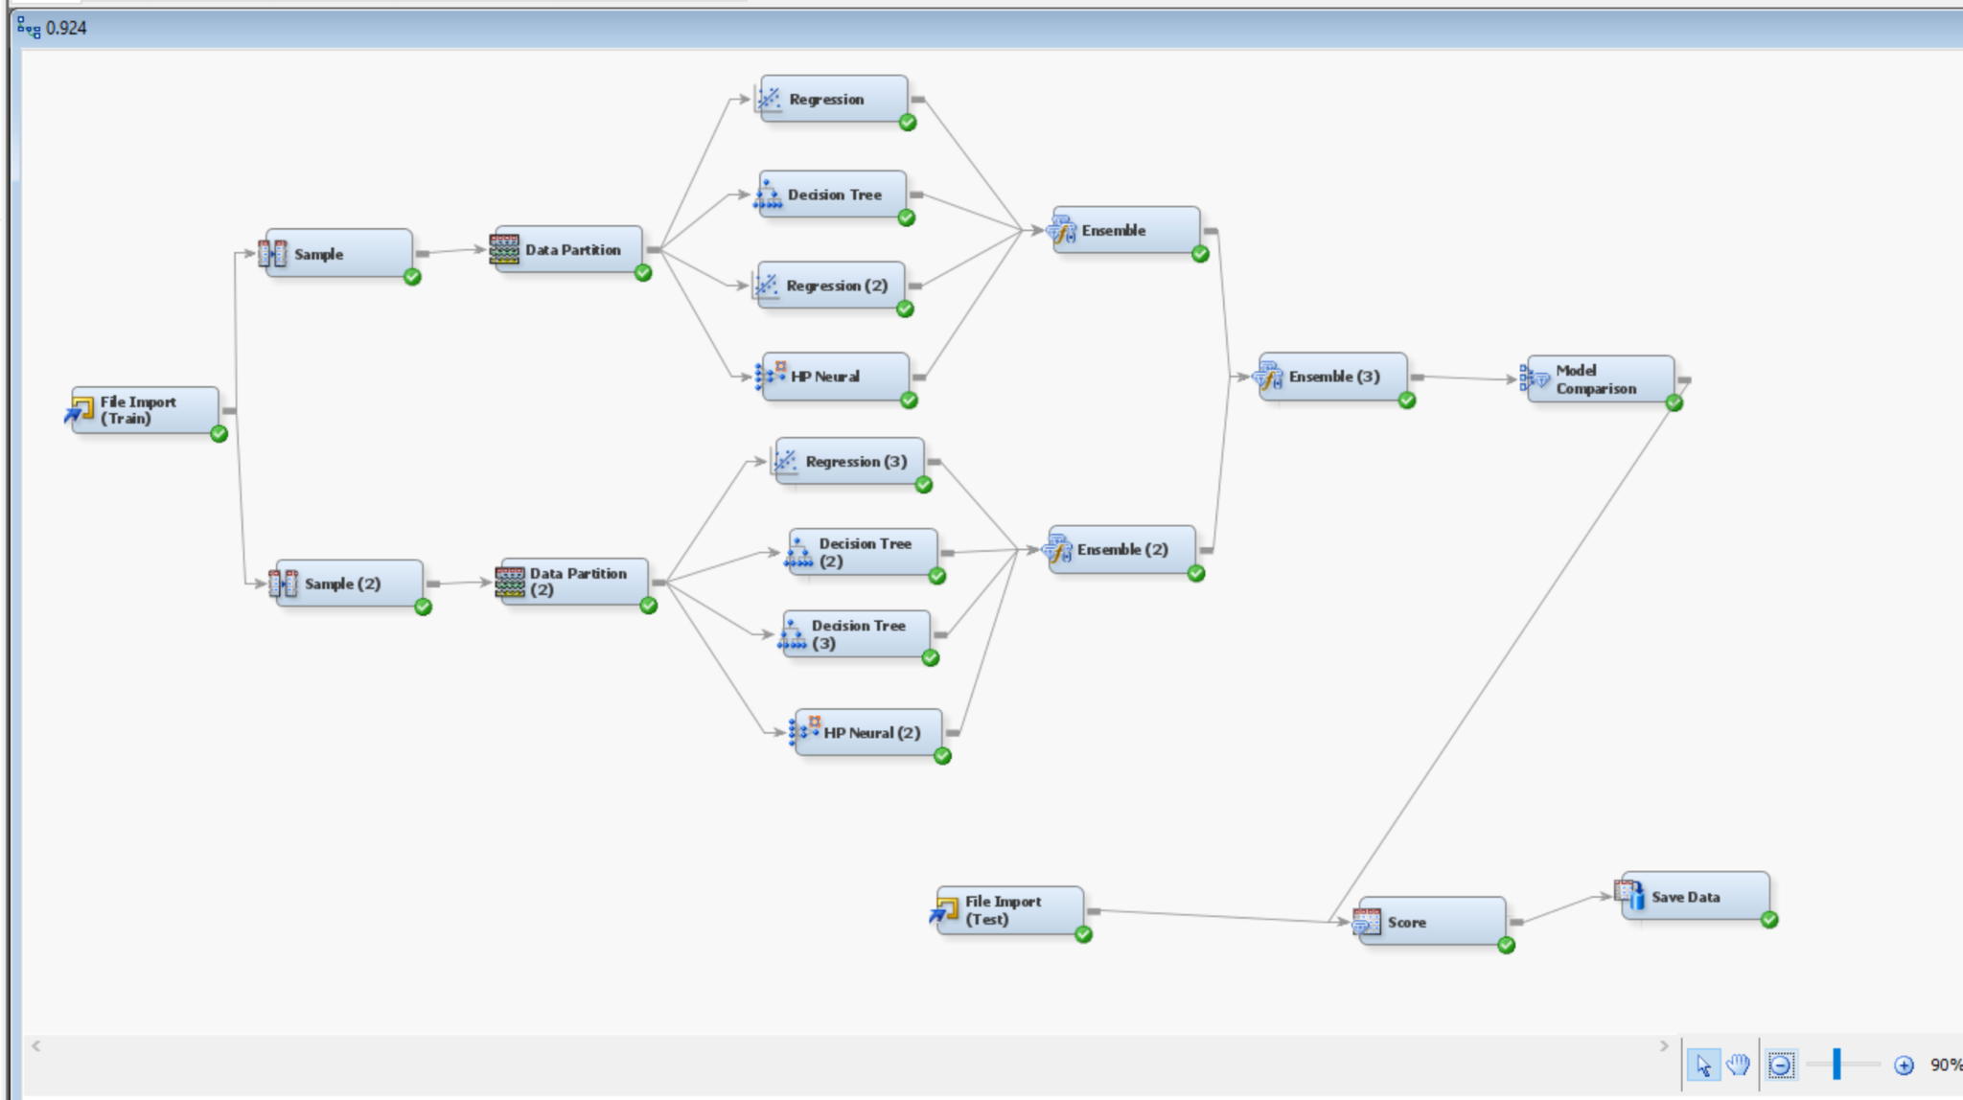
Main Model
ROC Score: 0.92467
Key Features:
Polynomial and Interaction Regressions: Unlocked complex relationships between variables.
Advanced Decision Trees: Delved deep with a maximum depth of 10 and branching factor of 4.
High-Performance Neural Networks: Captured non-linear patterns with precision.
Ensemble Power: Combined multiple methods for unparalleled accuracy.
Why It Shines: This model’s versatility made it a perfect fit for understanding the tangled web of financial metrics.

Slide 7
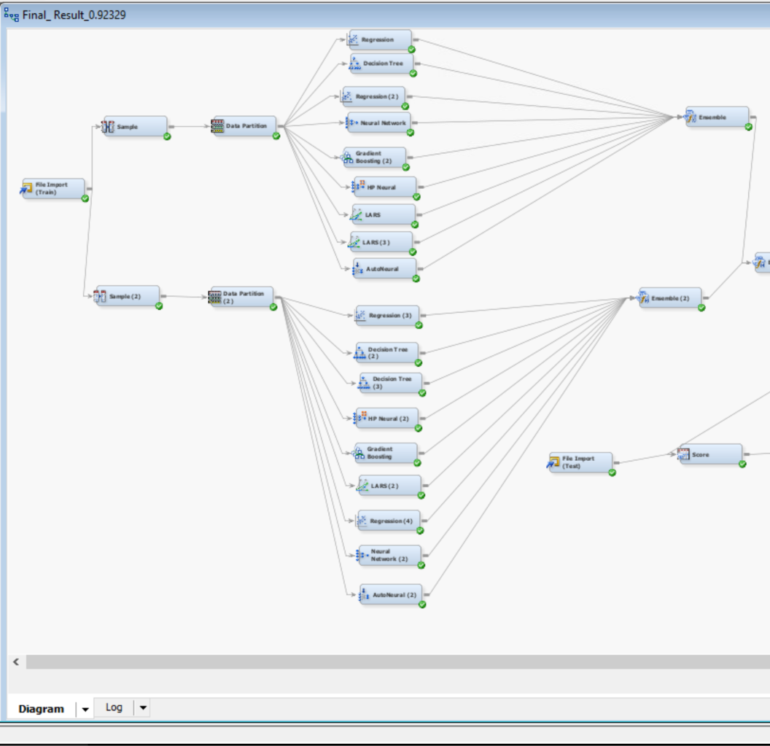
Other Model
ROC Score: 0.92329
Key Features:
Similar to Model 1 but more complex for faster deployment.
Prioritized interpretability, making it easier for real-time applications.
Why It Stands Out: Efficient, and nearly as accurate—a practical powerhouse.

Slide 8
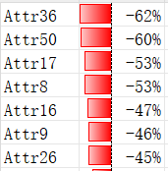
The Revelations
The models didn’t just predict bankruptcy; they told the story of how Oops & Fix ended up in this mess:
Attr36 (Total asset turnover)
The total asset turnover is too low (-0.61560), which may indicate inefficient utilization of assets to support sales.
Attr50 (Current assets-to-total liabilities ratio)
The current assets-to-total liabilities ratio is too low (-0.60300), suggesting that the company might face short-term liquidity pressures.
Attr8 (Equity-to-debt ratio)
The equity-to-debt ratio is too low (-0.52646), potentially indicating excessive reliance on debt financing, posing risks to the company's capital structure.
The data for this story is sourced from the fifth row of the train.csv file. These indicators were flagged as problematic because their values fall outside the predefined threshold range (below -0.5 or above 0.5).

Slide 9
SAVING Oops & Fix
The Comeback Plan:
1. Boost Asset Efficiency
2. Strengthen Liquidity
3. Enhance Profitability
Bankruptcy!!!!

Slide 10
Lesson Learnt
Ensemble Learning: Combining diverse models often yields better results than relying on a single model. This is because a variety of models can complement each other, reducing both bias and variance.
Model Selection and Optimization: With numerous models available for training, selecting the optimal model and effectively combining them is one of the most challenging aspects of the entire project.
Importance of Data Quality: The performance of a model heavily depends on the quality of the data and preprocessing steps. Handling missing values and ensuring data balance are critical to achieving better results.
Evaluation and Tuning: Continuous evaluation and parameter tuning are essential during model development to adapt to different datasets and improve overall performance.

Slide 11
Thanks for your attention!
Remember：models are like relationships—choose wisely, train often.

